Slide 1
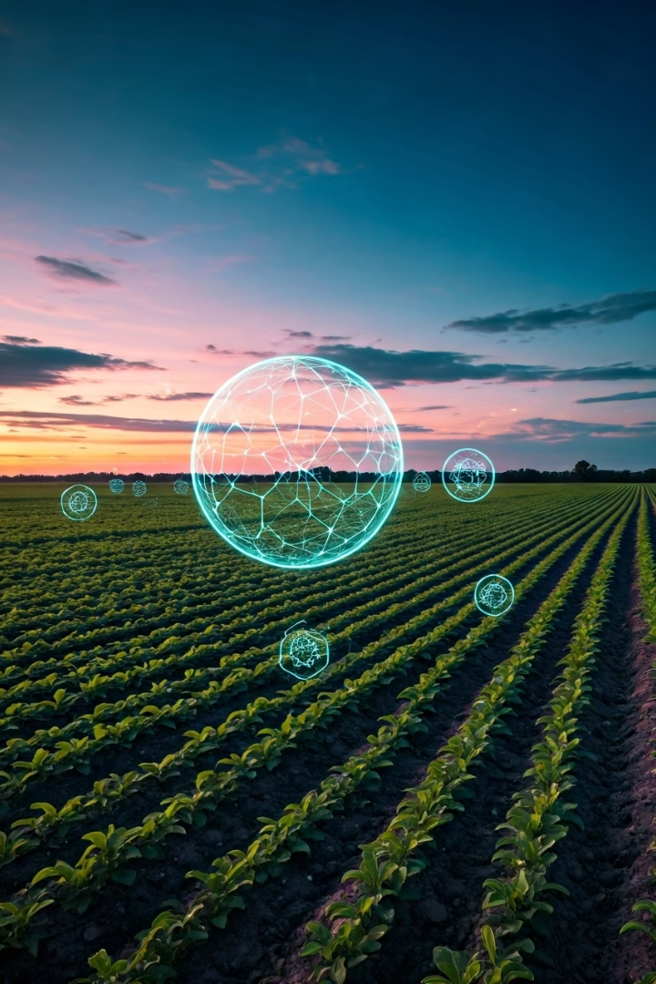
Smart Agriculture Platform: Empowering Farmers with AI
This presentation explores the innovative Smart Agriculture Platform, a comprehensive solution designed to optimize farming practices through machine learning. We will delve into its core functionalities, highlighting the algorithms and techniques that drive its powerful crop and fertilizer recommendation systems, alongside its robust marketplace and weather intelligence features.

Slide 2




Leveraging Machine Learning for Crop Optimization
Data Collection & Preprocessing
Gathering extensive datasets on soil composition (N, P, K, pH), temperature, humidity, and rainfall is the first critical step. This diverse data is cleaned and prepared to ensure accuracy and consistency for model training.
Crop Recommendation Model
The platform uses a pre-trained machine learning model, specifically a classification algorithm like Random Forest or Support Vector Machine. This model learns patterns from historical data to predict the most suitable crop for given environmental conditions, maximizing yield potential.
Prediction & Analysis
Farmers input their current soil and climate parameters. The model processes this data to provide a precise crop recommendation, alongside an analysis summary detailing the influential factors and a cultivation guide for the recommended crop.
Alternative Suggestions
To offer flexibility, the system also presents alternative crop recommendations with suitability percentages, allowing farmers to make informed decisions based on their specific needs and market demands.

Slide 3
Intelligent Fertilizer Recommendation System
Nutrient Analysis
ML-Powered Prediction
Application Schedule & Cost
The fertilizer recommendation module takes into account current soil nutrient levels (N, P, K, pH), crop type, and growth stage. It identifies deficiencies by comparing current levels against optimal nutrient requirements for the selected crop.
A pre-trained machine learning model, likely a regression or classification algorithm, is employed to predict the optimal fertilizer type. This model is trained on a dataset correlating soil properties, crop types, and environmental factors with effective fertilizer treatments.
Beyond just recommending a fertilizer, the system provides a detailed application schedule based on the crop's growth stage and estimated nutrient needs. It also calculates an estimated cost, helping farmers manage their budget effectively.

Slide 4




Key Machine Learning Algorithms Utilized
Random Forest
Support Vector Machines (SVM)
Regression Algorithms
Time Series Analysis
Often used for both classification (crop recommendation) and regression (fertilizer prediction), Random Forest leverages an ensemble of decision trees. It excels at handling complex datasets and provides robust predictions by averaging the output of multiple trees, reducing overfitting.
For tasks like predicting the optimal quantity of nutrients or yield, various regression algorithms (e.g., Linear Regression, Ridge Regression, Gradient Boosting) are employed. These models predict continuous values based on input features.
While not explicitly mentioned for recommendations, time series models (like ARIMA or Prophet) could be integrated for predicting future crop prices or weather patterns, enhancing the platform's predictive capabilities for market trends.
SVMs are powerful for classification tasks, making them suitable for crop recommendation. They work by finding the optimal hyperplane that best separates different classes in a high-dimensional feature space, proving effective even with limited data.

Slide 5

Integrating Real-time Weather Intelligence
1
Location-Based Data
The platform integrates with external weather APIs (e.g., OpenWeatherMap) to fetch real-time weather data based on the farmer's latitude and longitude. This provides crucial information like temperature, humidity, pressure, and wind speed.
2
Agricultural Recommendations
Based on the fetched weather data, the system generates immediate agricultural recommendations. For instance, high temperature triggers irrigation alerts, while low humidity prompts increased watering frequency.
3
7-Day Forecast
A mock 7-day forecast feature provides farmers with a glimpse into future weather conditions, including high/low temperatures, humidity, and general conditions (sunny, rainy, cloudy), aiding in proactive planning.

Slide 6
Dynamic Marketplace and Price Comparison
Marketplace Functionality
Price Comparison & Trends
Order Management & Alerts
The platform offers a comprehensive marketplace where farmers can list their crops for sale and buyers can browse available produce. It includes filters for searching, category selection, and sorting by price or newest listings.
An essential feature for informed decision-making, the price comparison module displays current market prices for various crops, showing changes from previous weeks. It also generates interactive line charts for price trends over time, providing valuable insights into market dynamics.
The platform streamlines order management for both buyers and sellers, tracking purchases and sales. Users can also set up price alerts, receiving notifications when a specific crop's price drops below or rises above a target, enabling timely transactions.
Browse and search available crops
Track purchase and sales orders
List new crops with details and images
Current market price overview
Set custom price alerts
Historical price trend visualization
Confirm or cancel orders
Manage existing crop listings (edit/delete)
Regional price comparison across markets

Slide 7






Data Management and User Authentication
Secure User Authentication
The platform ensures secure access through a robust login/registration system using phone numbers. User sessions are managed to maintain continuity and personalize the experience for each farmer.
SQLite Database Integration
A local SQLite database is used to store all critical application data, including user profiles, crop listings, order details, and historical price information. This ensures data persistence and efficient retrieval.
Database Initialization
Upon first run, the system automatically initializes the database, creating necessary tables like "users," "crops," "orders," and "price_history" to set up the foundational data structure for the platform.
This foundational layer provides the security and data integrity necessary for the Smart Agriculture Platform to function reliably, safeguarding user information and enabling seamless operations.

Slide 8
Future Enhancements and Next Steps
Advanced Predictive Analytics: Implement more sophisticated machine learning models for yield prediction, disease detection, and pest forecasting, leveraging image recognition and sensor data. This can include CNNs for image analysis of crop health.
IoT Integration: Connect with smart sensors and IoT devices in the field to collect real-time soil moisture, nutrient levels, and microclimate data, feeding directly into the recommendation models for even greater accuracy.
Blockchain for Supply Chain Transparency: Explore blockchain technology to ensure transparent and traceable supply chains, enhancing trust and authenticity in the marketplace.
Personalized Farmer Dashboards: Develop highly customizable dashboards allowing farmers to visualize their specific farm data, track progress, and receive tailored insights based on their unique farming practices and goals.
Community and Collaboration Features: Introduce forums or chat functionalities for farmers to share knowledge, discuss challenges, and collaborate on best practices, fostering a supportive agricultural community.

